Slide 1




From weekly preprints to a live database
AGENT ARCHITECTURE
LitVault
filters
Extraction
Agent extracts
Database
grows
LitVault picks the papers worth reading. The Extraction Agent turns them into rows.
Notes:
This deck shows how the two agents fit together. LitVault screens the week’s preprints and decides which papers matter. The Extraction Agent reads those papers and writes the fields we care about into a database that keeps growing every week.

Slide 2

A short story about literature reviews on the throne.
LITVAULT · INTRO
Notes:
Open with a question everyone can relate to. Most of us don’t sit down to “do a literature search” — we catch papers in spare minutes, often on our phones, often in the bathroom.

Slide 3


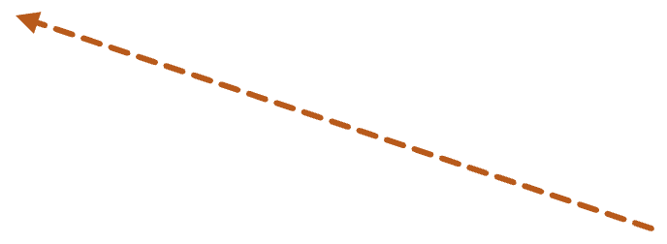
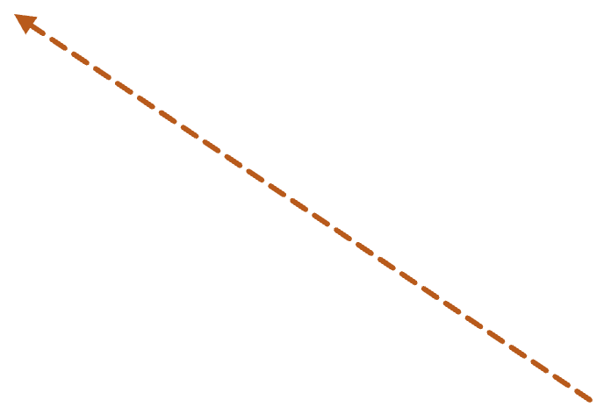
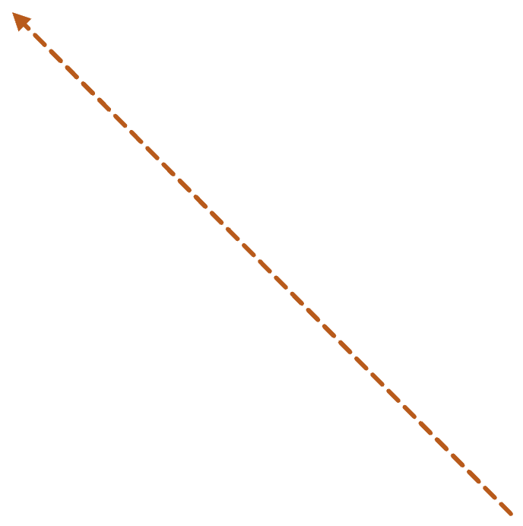



The morning scroll
Four feeds. Five spare minutes. Whatever floats to the top.
X and Bluesky threads
Slack links from the lab
Journal email alerts
Google Scholar picks
Notes:
Meet our researcher. Every morning, a few minutes on the toilet, phone in hand. Papers come in from everywhere: social media threads, Slack links from labmates, journal alerts, Scholar recommendations. Whatever is on top of the feed is what gets read.

Slide 4
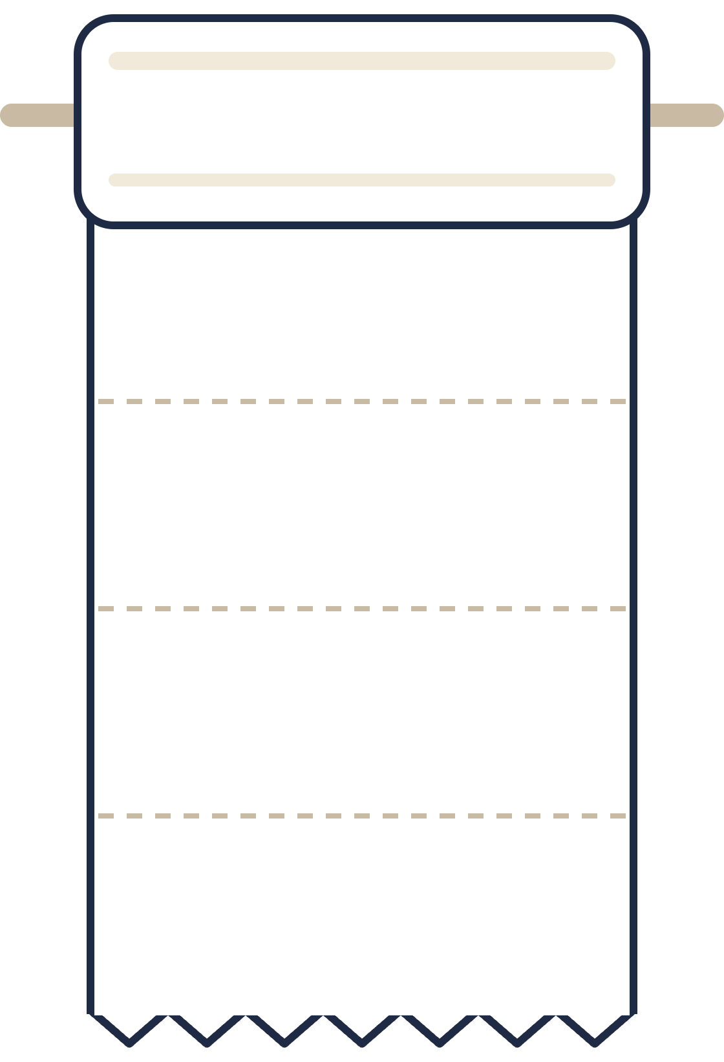
He grabs whatever paper is within reach
X / BLUESKY
A thread with 2k likes
SLACK
His reading list works like the roll on the wall: you take the next sheet, not the best one.
A link dropped in #random
Reading by proximity, not relevance.
EMAIL ALERT
Keywords set years ago
SCHOLAR
Whoever cited you
Notes:
Here’s the pun: his literature diet is basically toilet paper. Whatever sheet is next on the roll — a viral thread, a random Slack link, an old keyword alert — that’s what he reads. Not because it’s the most important paper, just because it’s within reach.

Slide 5

Then the messages arrive
LABMATE
did you see this preprint?? it’s basically your project
PI
This is very relevant to your thesis. Let’s discuss it on Friday.
FRIEND IN ANOTHER LAB
btw it went up three weeks ago
Notes:
And yet — despite all that scrolling — his labmate, his PI and a friend still send him papers he never saw. Important ones. Directly relevant to his thesis. They reached him eventually, but secondhand and weeks late.

Slide 6




Meet LitVault
WEEKLY DIGEST AGENT
1. Screen
2. Score
3. Sort
4. Vault
Every bioRxiv, medRxiv and ChemRxiv abstract from the past 7 days
Claude rates each one 0–100 for relevance to your topic
Papers land in High, Check and Low groups
Drag cards into Must read, Methods or Discard, then download the PDFs
Fewer “did you see this?” messages.
Notes:
That’s LitVault. Once a week it screens every new abstract on bioRxiv, medRxiv and ChemRxiv, has Claude score each one for relevance to your topic, groups them into High, Check and Low, and gives you a board where you drag papers into vaults and download the PDFs. You still read on the toilet — but now you read the right papers.

Slide 7







What’s more?
LitVault decides what to read. The Extraction Agent turns what you kept into database rows.
Research profile (.md)
fields.yaml: what to extract
STAGE 1 · FILTER
STAGE 2 · EXTRACT
OUTPUT
SOURCES
LitVault
Extraction Agent
Live database
bioRxiv
Fetch new abstracts
Load the PDF
SQLite tables
Must-read
PDFs
medRxiv
Keyword screen
Extract fields (LLM)
Cross-paper fill
ChemRxiv
Claude scores 0–100
Validate types
CSV export
You file into vaults
Retry on error (≤3×)
Runs every week: new preprints in, new rows out.
Notes:
Here’s the whole system on one slide. On the left, the sources: every new preprint on bioRxiv, medRxiv and ChemRxiv. Stage one is LitVault. It uses my research profile to screen and score the week’s abstracts, and I file the important ones into a Must read vault. Those PDFs are the handoff. Stage two is the Extraction Agent. It reads each PDF against a schema in fields.yaml, validates the output and retries when the model gets it wrong. Everything lands in a SQLite database that grows every week.

Slide 8





The Extraction Agent reads each PDF
STAGE 2 · EXTRACT
LANGGRAPH LOOP, PER PAPER
FIELDS.YAML · MCFA EXAMPLE, ONE ROW PER MICROBE
retry with the exact error
Field | Type | Holds
microbe_name | string | Organism and strain
makes_mcfa | boolean | Makes C6–C12 acids?
mcfa_products | list | caproate, caprylate…
mcfa_titer | string | Best titer, with units
isolation_source | string | Where it came from
source_type | string | gut/rumen, soil, sludge…
strain_origin | string | Isolated, collection, lab
load_pdf
extract
validate
ok
→ database
PDF mode: native (figures and tables readable) or text (cheaper)
Model: any OpenRouter model with structured outputs
Notes:
Stage two. Each PDF goes through a small LangGraph graph: load the PDF, extract the fields, validate every field against its declared type. If the JSON is bad or a type is wrong, the validator tells the model exactly what was wrong and it tries again, up to three times. The schema is just a YAML file — here it’s our MCFA example, one row per microbe — so the same agent works for any topic.

Slide 9
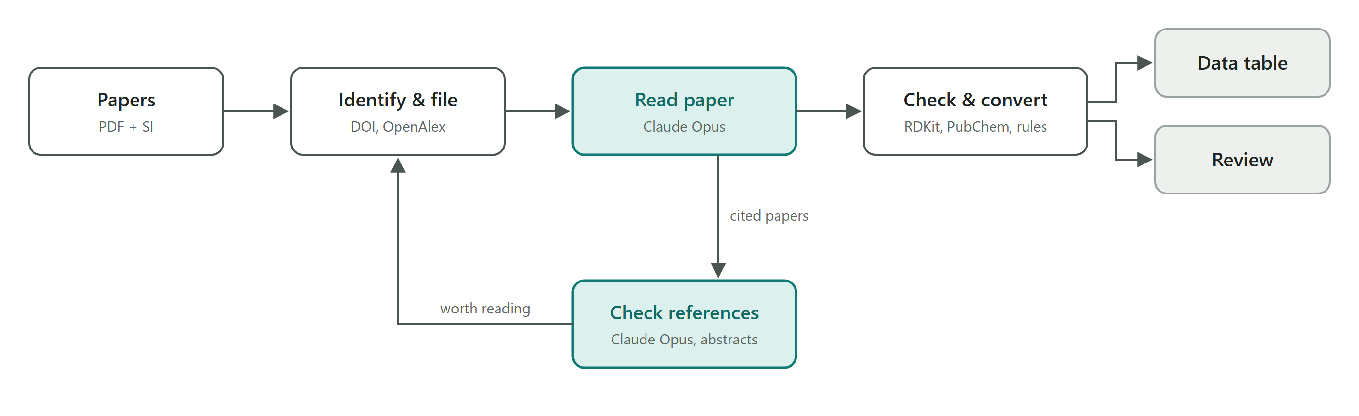
The Extraction Agent also identifies the key references cited in the paper.
STAGE 2 · EXTRACT
Notes:
Stage two. Each PDF goes through a small LangGraph graph: load the PDF, extract the fields, validate every field against its declared type. If the JSON is bad or a type is wrong, the validator tells the model exactly what was wrong and it tries again, up to three times. The schema is just a YAML file — here it’s our MCFA example, one row per microbe — so the same agent works for any topic.

Slide 10




The database stays live
THE OUTPUT
Only new papers run
The schema can grow
Each PDF is keyed by a hash of its contents. With --watch, PDFs dropped into papers/ are picked up as they arrive.
Add a field to fields.yaml and the column appears. --refill re-extracts older papers to fill it.
Gaps filled across papers
Failures stay visible
Carries information about an entity from one paper to another when its identity and identifier match, while recording the source.
status lists rejected papers and need extra review; run --retry-errors tries them again. Export to CSV for Excel or pandas.
Notes:
Why call it a live database? Four properties. Re-runs only process papers it hasn’t seen, keyed by content hash, and watch mode picks up new PDFs automatically. The schema can grow — add a field, and refill back-fills old papers. The fill step borrows a strain’s isolation source from another paper, but only on a strict match, and it records the source paper so borrowed values are always traceable. And failures are listed, not hidden.

Slide 11
Organism records found, three runs of identical input (16 Papers)
STAGE 3 · EVALUATIONS: RUN-TO-RUN VARIABILITY
System | Run 1 | Run 2 | Run 3
Agent | 29 | 29 | 29
Baseline | 23 | 23 | 26
The agent returned the same count every time. The baseline moved by three records between runs, so any single comparison of the two is reading one draw from a distribution.
Neither system sets a temperature or a seed; both use the model’s default sampling.
Notes:
The earlier single-run comparison showed 29 against 24. That 24 was one sample from a 23 to 26 range, which is why repeating the run matters before quoting a difference.

Slide 12
Field values that came back identical in all three runs
STAGE 3 · EVALUATIONS: RUN-TO-RUN VARIABILITY
Field | Agent | Baseline
Makes MCFA | 100% | 100%
MCFA products | 100% | 95%
Source type | 100% | 90%
Strain origin | 96% | 85%
Isolation source | 64% | 45%
MCFA titer | 40% | 25%
The split is by field type, not by system. Categorical answers repeat; free text is rewritten each run. Both systems show the same pattern, the baseline more strongly.
Measured on organisms that appeared in every run: 29 for the agent, 20 for the baseline.
Notes:
Do not read the 40% and 25% titer rows as error rates. The next slide shows that almost all of that movement is rephrasing, not a change in the measurement.

Slide 13
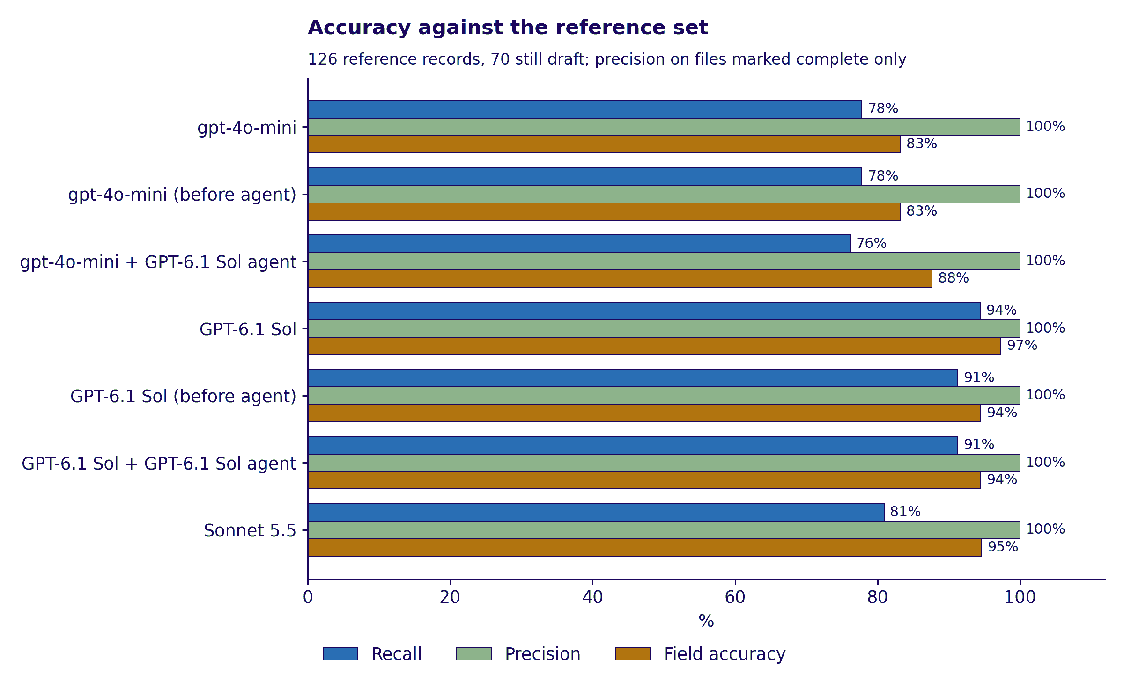
STAGE 3 · EVALUATIONS: MODEL VARIABILITY
Notes:
Do not read the 40% and 25% titer rows as error rates. The next slide shows that almost all of that movement is rephrasing, not a change in the measurement.

Slide 14
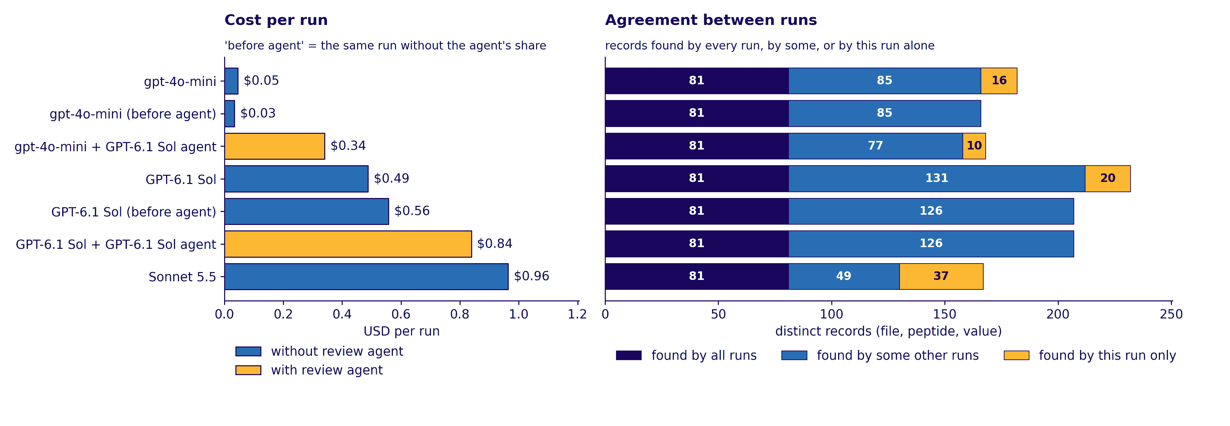
STAGE 3 · EVALUATIONS: MODEL VARIABILITY
Notes:
Do not read the 40% and 25% titer rows as error rates. The next slide shows that almost all of that movement is rephrasing, not a change in the measurement.

Slide 15
LitVault decides what’s worth reading. The Extraction Agent remembers what it said.
IN ONE LINE
Notes:
To sum up: LitVault is the filter, so nothing important slips past. The Extraction Agent is the memory, so what we read becomes structured data we can query, instead of notes we forget.

